Slide 1
Preprocess Time Series

Slide 2
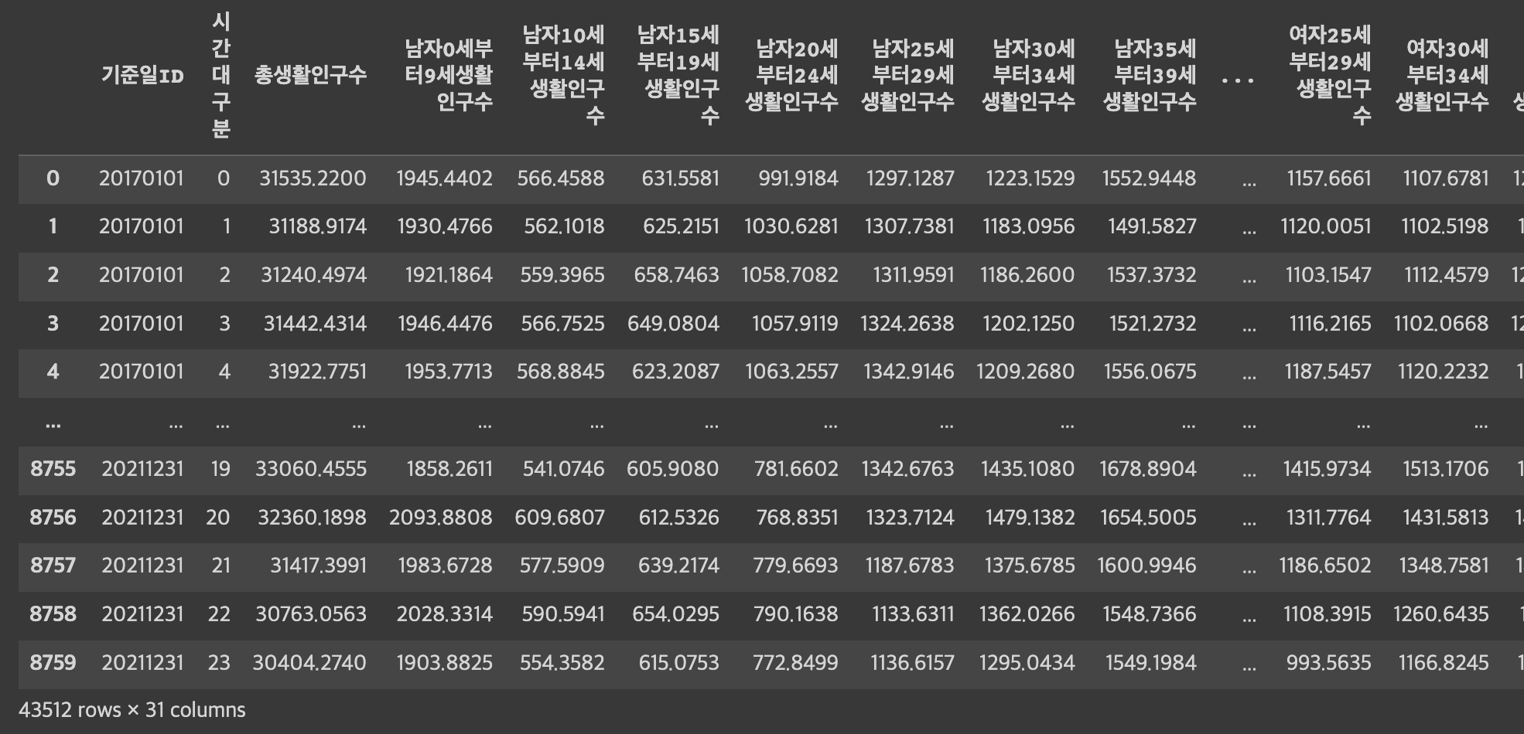
Data
2017 - 2021 Active Population Data
Goal: forecast 2month data

Slide 3
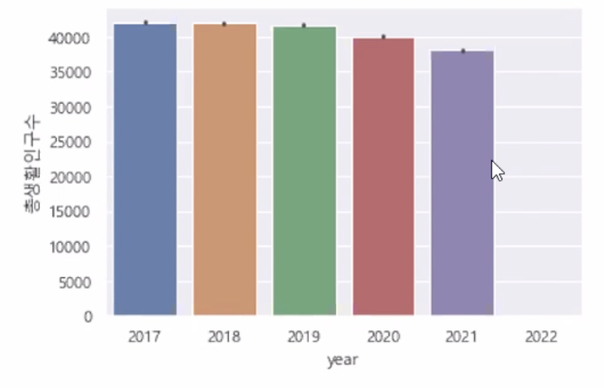
Domain knowledge
2019-2020 appearance of Covid-19
2021 infection rates peak
2022 ???

Slide 4
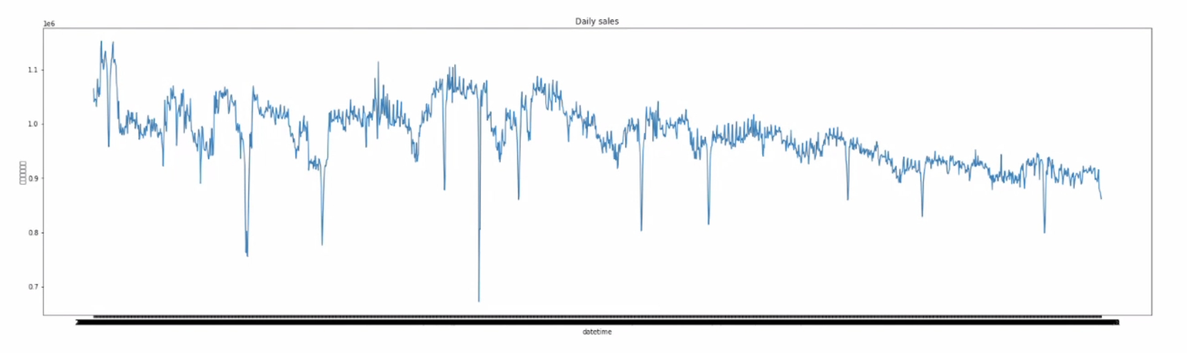
Outliers

Slide 5
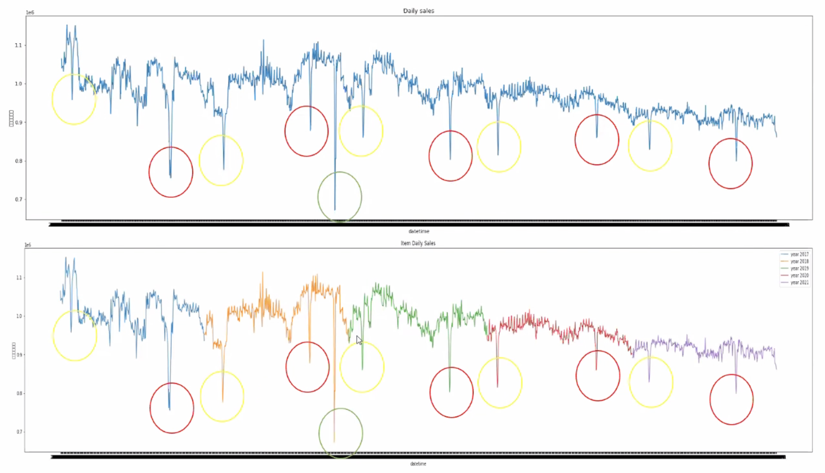
Getting Trend from Outliers
red: 추석
yellow: 설날
green: lost
(fire on data center)

Slide 6
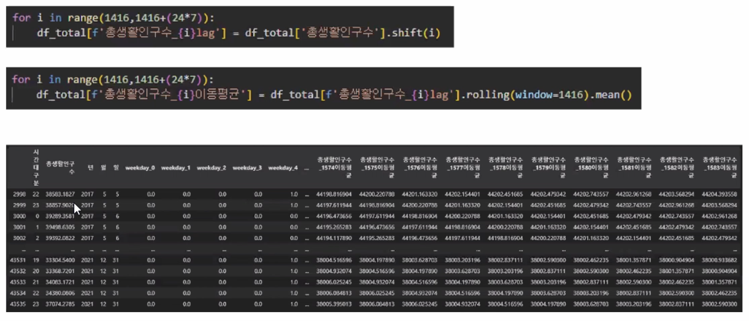
Shift and Rolling

Slide 7
result
RMSE 982

